Slide 1
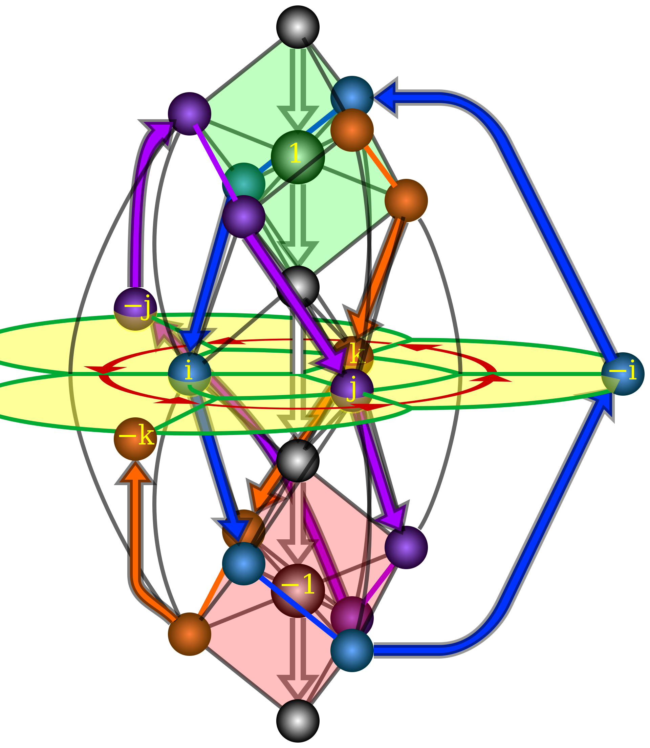
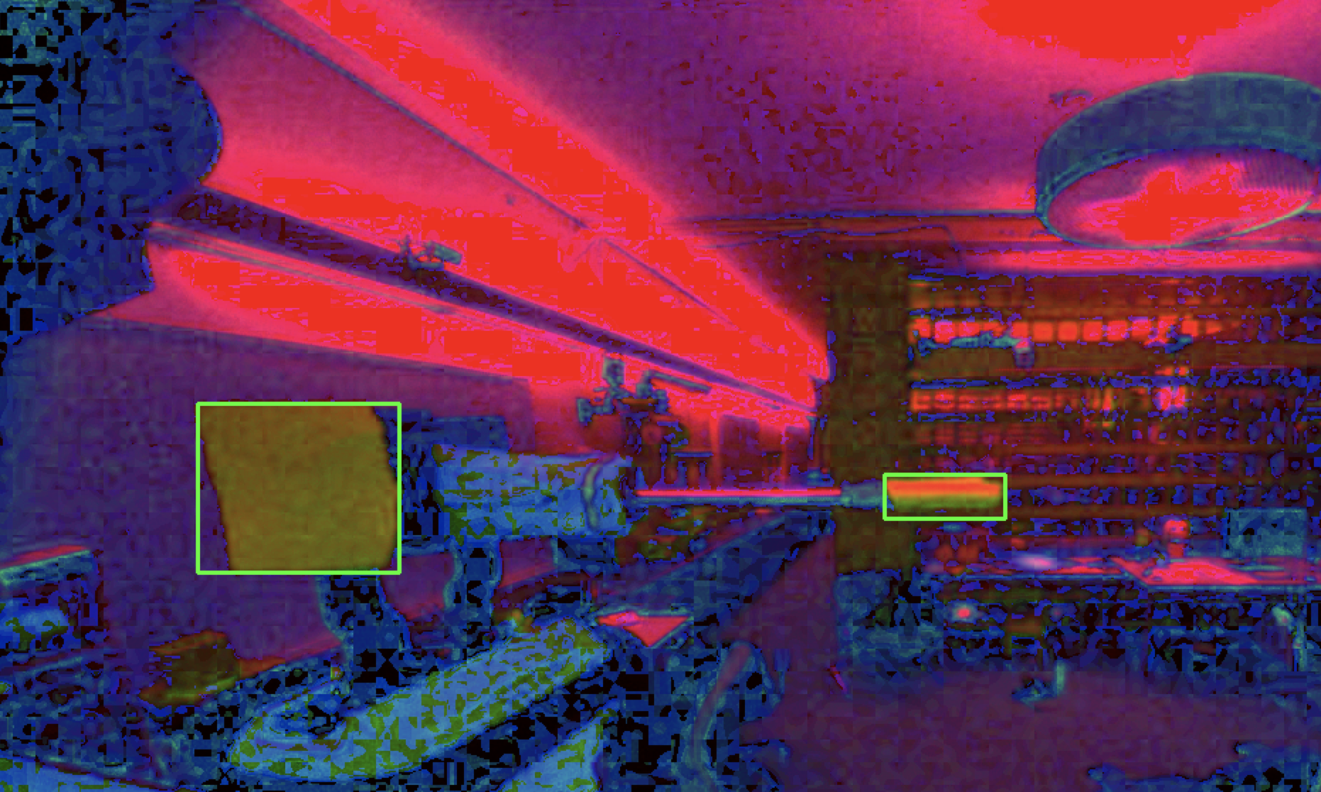
Teaching Baxter to Use Tools
Given a known task and tool, can Baxter learn the inverse kinematics of a new tool and use it to accomplish a specific task?
Computer Vision
Extend Inverse Kinematics
Reinforcement Learning
Notes:
Note: the bottom two images are gifs, and are most exciting if included as a PowerPoint slide and not exported as a pdf

